Slide 1

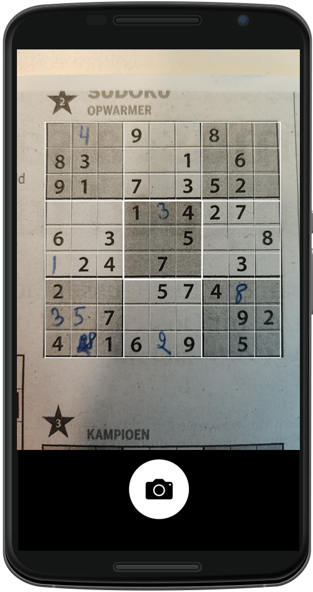
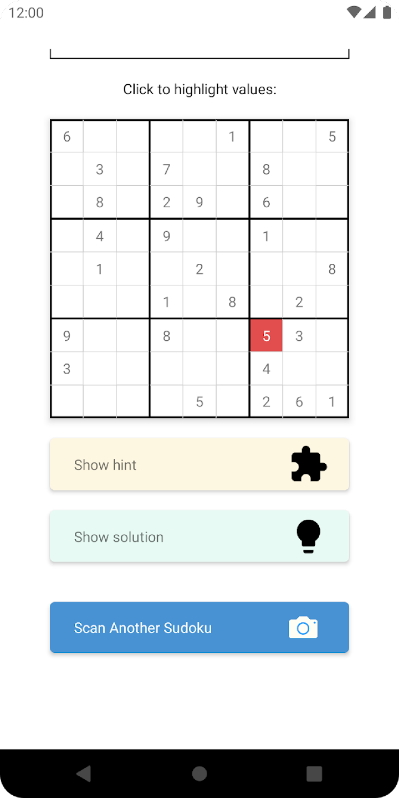
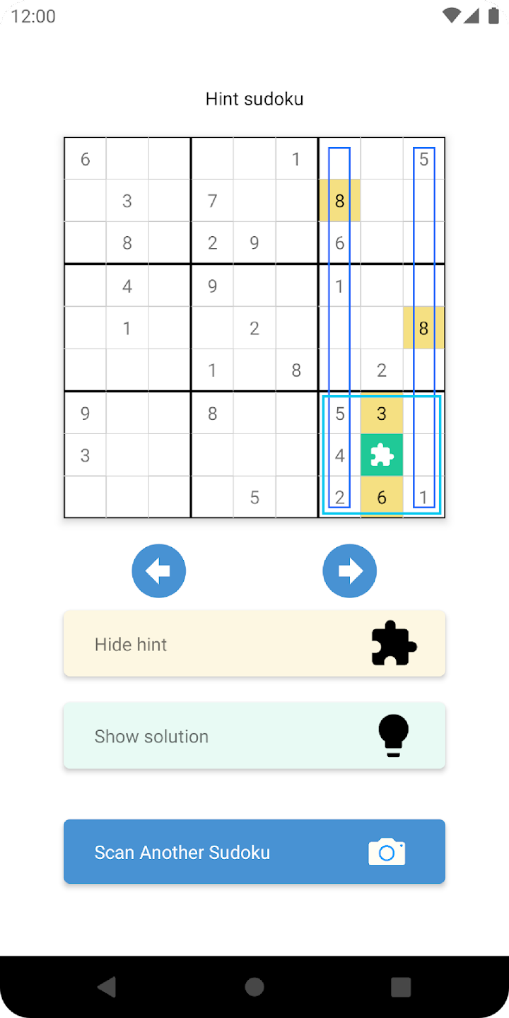
Sudoku Assistant, explanation steps

Slide 2
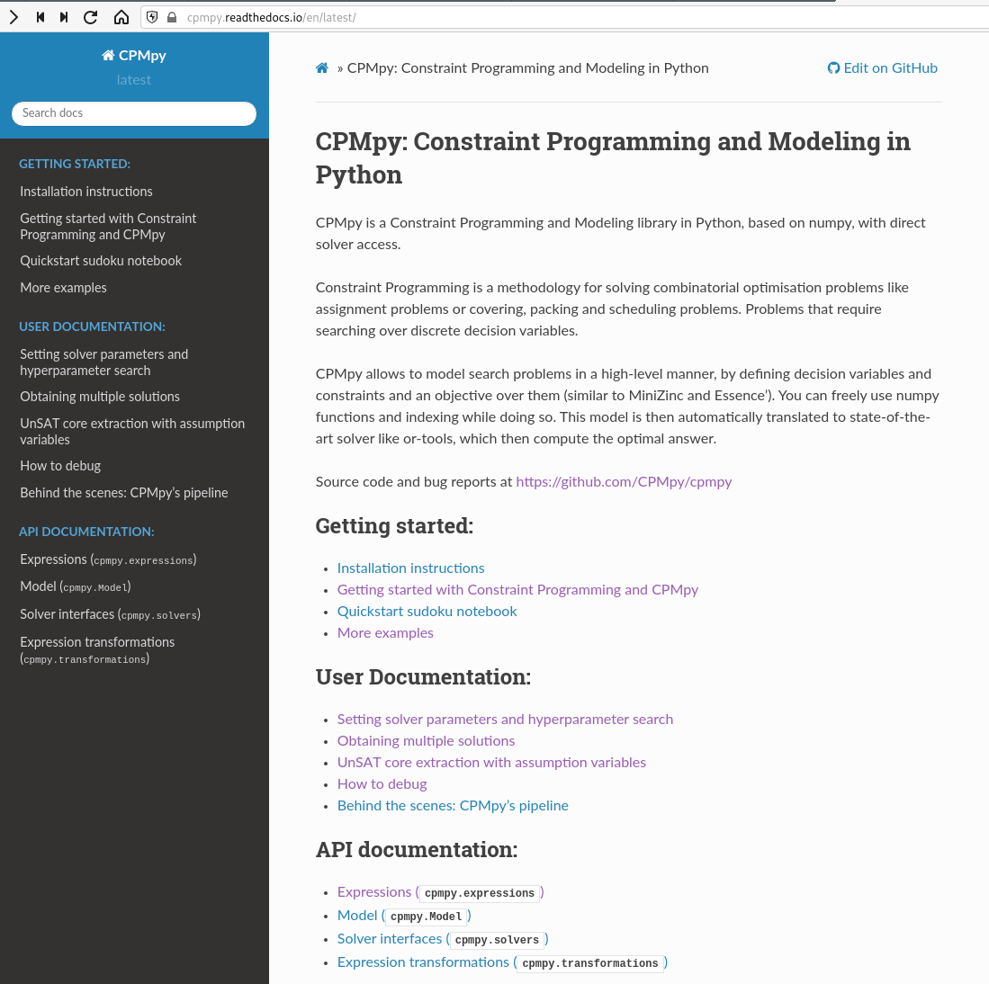
https://github.com/CPMpy/cpmpy
Open source
Python/Numpy based
Direct, incremental solver access
Supported solvers:
ORTools (CP)
Exact (PseudoBoolean+int)
Gurobi (ILP)
Z3 (SMT)
PySAT, PySDD (SAT, know. comp.)
More to come… (Choco, SCIP, CP Opt)

Slide 3
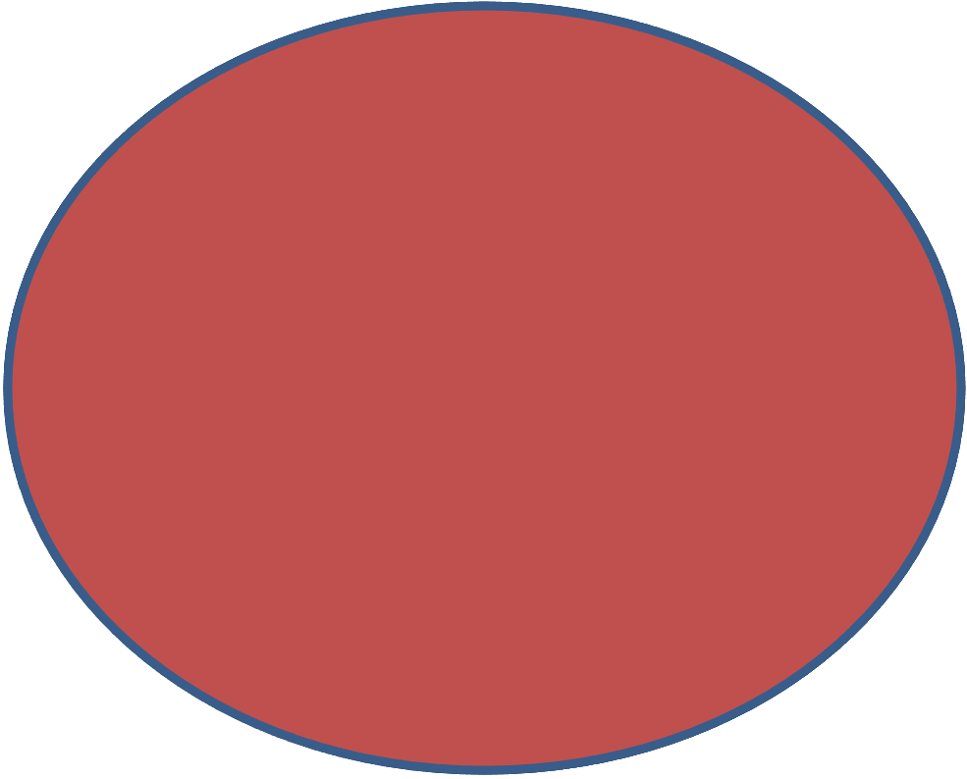
All Constraints

Slide 4
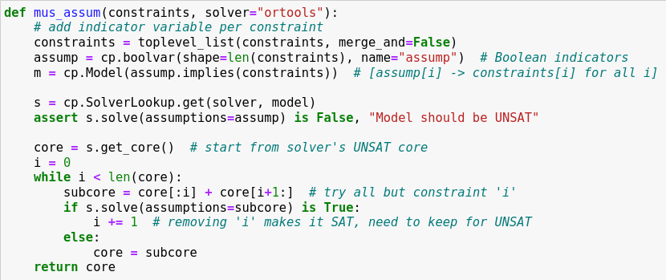
1) Add Boolean indicator variables
2) Assume they are set to ‘true’
3) Extract an unsat subset from solver
4) Incrementally solve diff. subsets

Slide 5
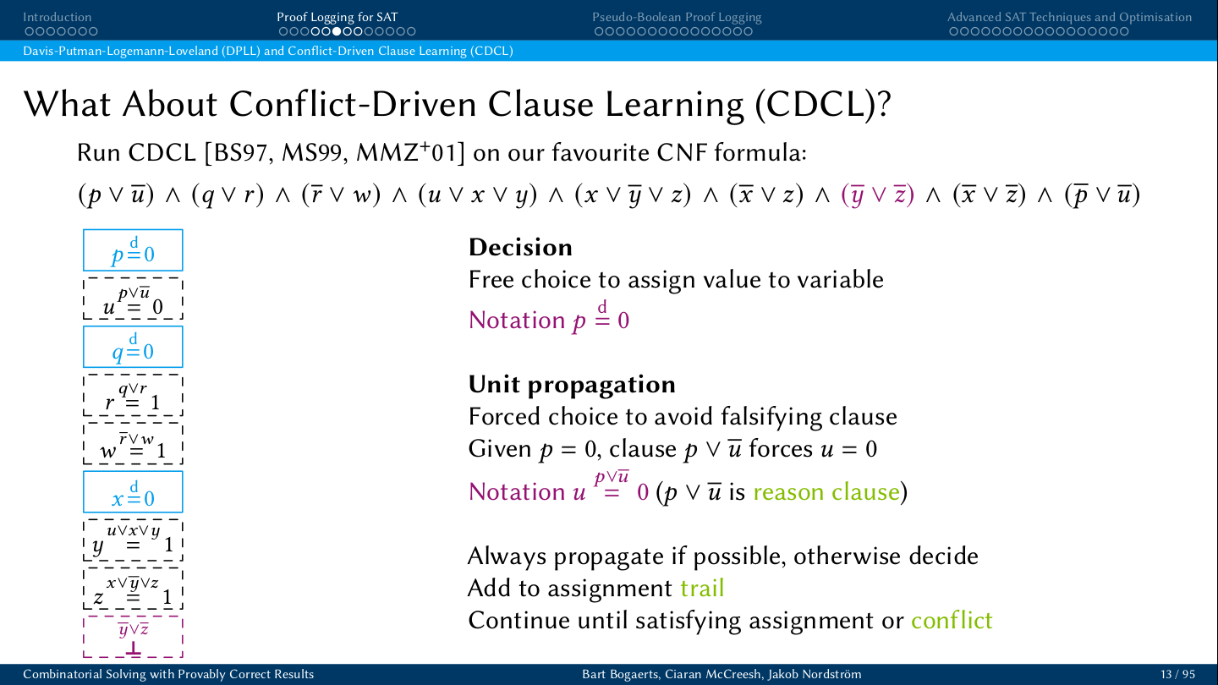
Decision
Unit propagation
Conflict detected

Slide 6
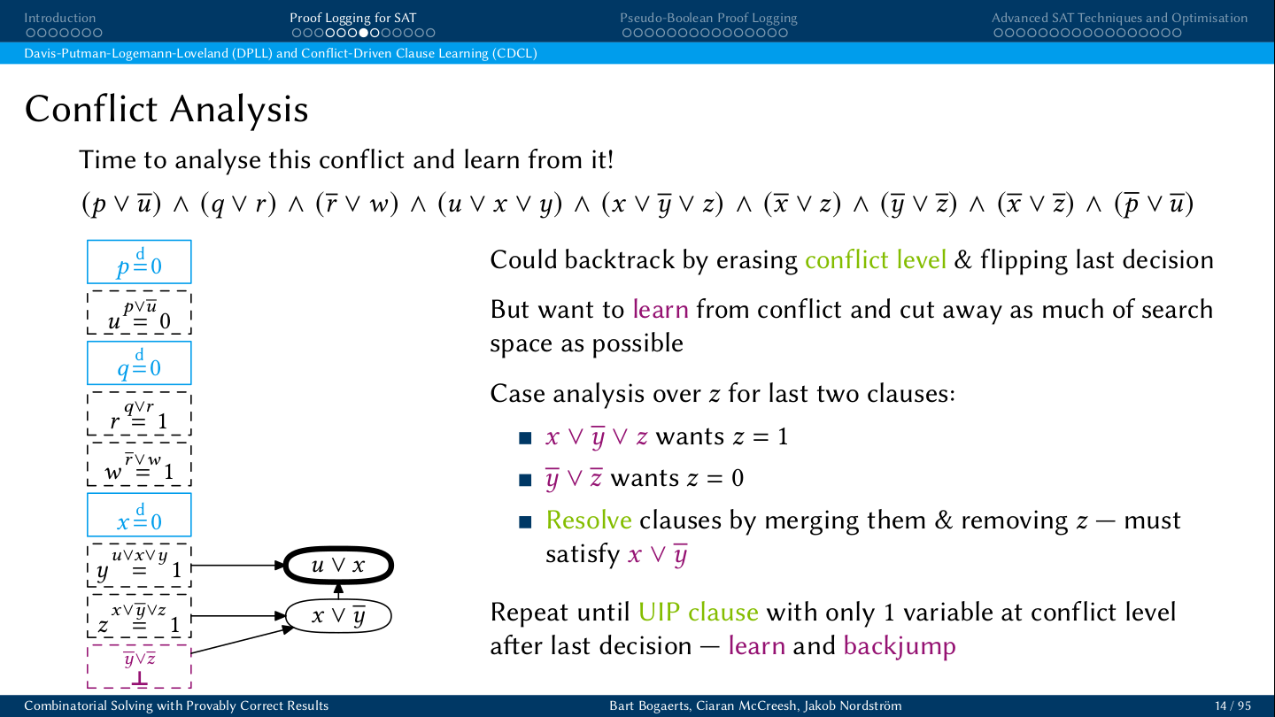
`
Clause learning

Slide 7
`
Assumption variables
a1 \/
a2 \/
a3 \/
a4 \/
a5 \/
a6 \/
a7 \/
a8 \/
a9 \/
a1 = 1
Clause learning with assumptions
a2 = 1
a1 \/
a3 = 1
a4 = 1
a5 = 1
a6 = 1
a2 \/
a7 = 1
a8 = 1
a5 \/
a3 \/
a9 = 1
a7 \/
a4 \/
\/ a5 \/ a7
\/ a4 \/ a5 \/ a7
a5 \/
\/ a5 \/ a7
a7 \/

Slide 8
`
Assumption variables
a1 \/
a2 \/
a3 \/
a4 \/
a5 \/
a6 \/
a7 \/
a8 \/
a9 \/
Clause learning with assumptions
Can extract UNSAT core: assumption variables present in ‘final’ conflict
Can solve repeatedly with diff. assumption variables learned clauses remain valid (contain the assumps)
a1 = 1
a2 = 1
a1 \/
a3 = 1
a4 = 1
a5 = 1
a6 = 1
a2 \/
a7 = 1
a8 = 1
a3 \/
a9 = 1
a4 \/
\/ a4 \/ a5 \/ a7
a5 \/
\/ a5 \/ a7
a7 \/

Slide 9
1 2 3 4 5 6 7 8 most to least preferred (lexico)
1 2 3 4 5 6 7 8 : SAT check constraints
1 2 3 4 5 6 7 8 : SAT other constraints
1 2 3 4 5 6 7 8 : UNSAT in the mus
1 2 3 4 5 6 7 8
1 2 3 4 5 6 7 8 : UNSAT
1 2 3 4 5 6 7 8 : SAT
1 2 3 4 5 6 7 8 : SAT
1 2 3 4 5 6 7 8 : SAT
1 2 3 4 5 6 7 8 : SAT
1 2 3 4 5 6 7 8 : UNSAT
1 2 3 4 5 6 7 8 : done

Slide 10
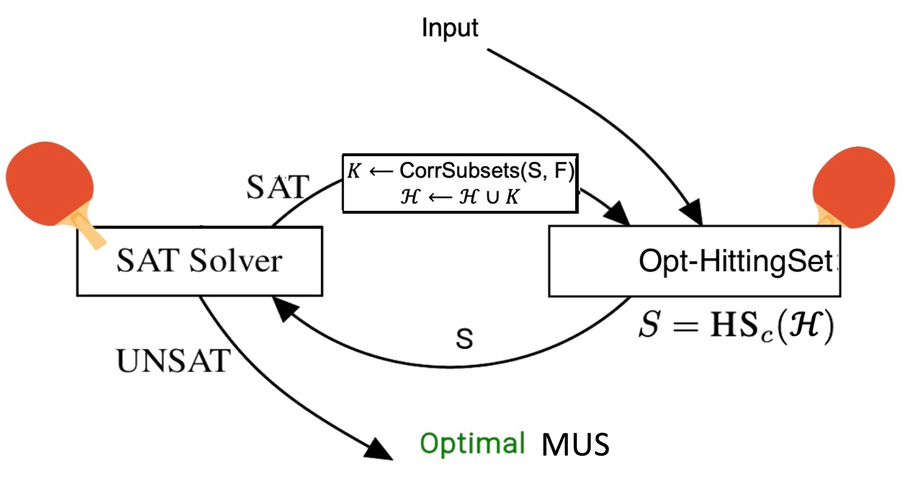
Incremental clause learning solver (e.g. PySAT, Exact)
Incremental HS solver (e.g. Gurobi)
Add multiple (cheap) MCSes

Slide 11
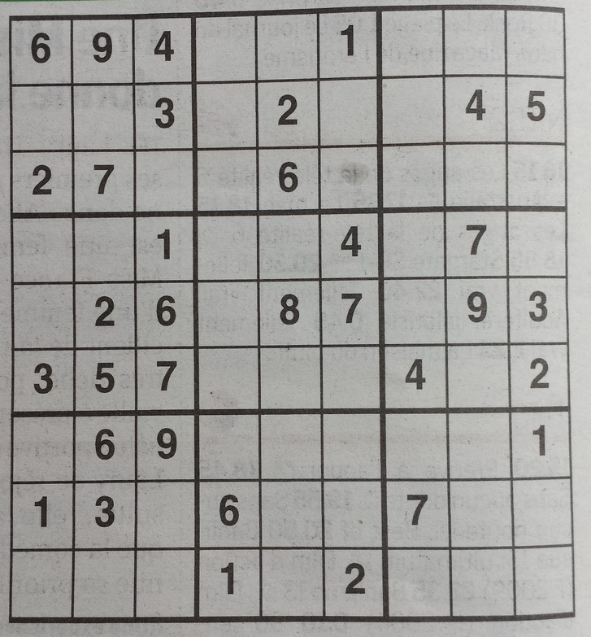
How to explain satisfiability of a constraint satisfaction problem (CSP)
in a human-understandable way?
Explain the maximal consequence of a CSP
C
constraints: e.g. all different values on a row, block, and column
8
5
2
3
7
8
1
7
9
6
5
4
3
9
1
8
initial (partial) interpretation (facts):
- ∅
- cells[1,1]=6,cells[1,2]=9,…,cells[8,7]=7
9
8
2
3
5
6
I₀
4
5
1
9
1
6
8
I_{end}
7
3
4
5
8
2
maximal consequence: precision- maximal partial interpretation
2
9
8
5
4
5
4
8
7
3
6
9
C
∧
I₀
|
I_{end}
=
I₀
I_{end}

Slide 12
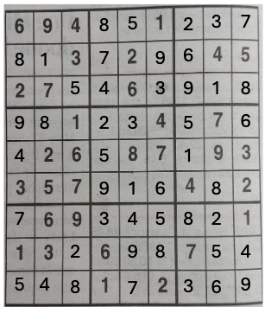
Chapter 3: A framework for step-wise explaining how to solve CSPs
Step-wise explaining the maximal consequence
Explanation-producing problem
C
constraints: e.g. all different values on a row, block, and column
8
5
2
3
7
I₀
initial (partial) interpretation (facts):
∅
cells[1,1]=6,cells[1,2]=9,…,cells[8,7]=7
8
1
7
9
6
5
4
3
9
1
8
9
8
2
3
5
6
I_{end}
maximal consequence: precision- maximal partial interpretation
4
5
1
9
1
6
8
7
3
4
5
8
2
C
∧
I₀
|
I_{end}
2
9
8
5
4
=
5
4
8
7
3
6
9
Decompose explaining the maximal consequence into a sequence of inference steps.
A partial interpretation I_{i} is gradually completed at every step i until the maximal consequence (I_{end} ) is explained.
I₀
I_{end}
5
5
….
1
I₀
I₁
I₂
I_{end}
Notes:
11

Slide 13
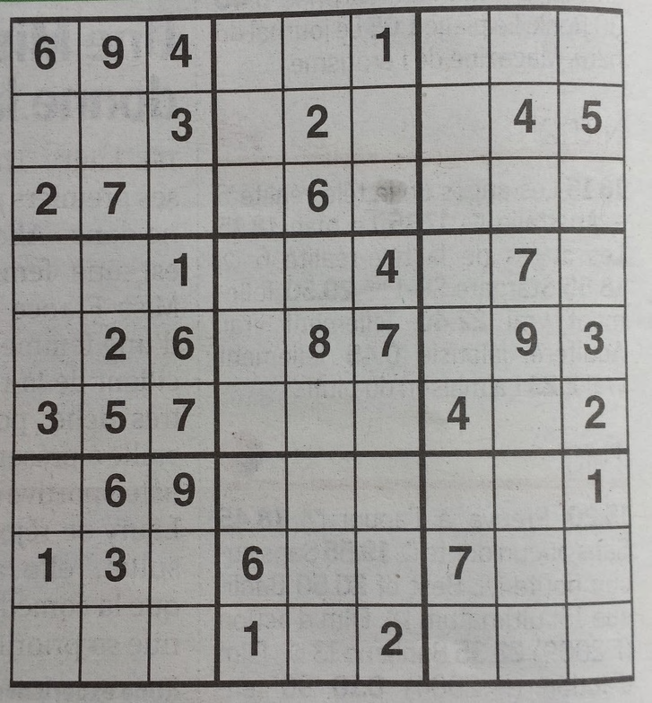
Chapter 3: A framework for step-wise explaining how to solve CSPs
Step-wise explaining the maximal consequence
Explanation Step
An EXPLANATION (E_{i}, S_{i}, N_{i}) of an inference step explains:
C
constraints: e.g. all different values on a row, block, and column
E_{i}
S_{i}
=
N_{i}
∧
|
I₀
initial (partial) interpretation (facts):
∅
cells[1,1]=6,cells[1,2]=9,…,cells[8,7]=7
E_{i}
E_{i} ⊆ I_{i}
The explaining facts are a subset of what was previously derived
I_{end}
maximal consequence: precision- maximal partial interpretation
C
∧
I₀
|
I_{end}
=
E₀ = {cells[1,1] = 6, cells[1,2] = 9, cells[1,3] = 4,
cells[3,1] = 2, cells[3,2] = 7, cells[2,9] = 5}
6
9
4
S_{i}
S_{i} ⊆ C
A subset of the problem constraints
5
2
7
5
S₀ = {alldifferent(cells[1:3, 1:3]), alldifferent(cells[2, :])}
N_{i}
I_{i+1}\I_{i}
All newly derived information entailed by this explanation
I₀
I₀
I₁
I₁
N₀ = {cells[3,3] = 5}
+ N₀
Notes:
11

Slide 14
8
5
2
3
7
6
9
4
1
8
1
7
9
6
5
5
4
3
9
1
8
5
2
7
5
5
2
3
5
6
1
9
8
8
….
4
5
1
1
9
1
6
8
1
7
3
4
5
8
2
1
2
9
8
5
4
5
4
8
7
3
6
9
E₀
∧
S₀
∧
E₂
∧
E₁
S₁
S₂
I₀
I₁
I₂
….
I_{end}
+
N₀
+
N₁
+
N₂
Notes:
11

Slide 15
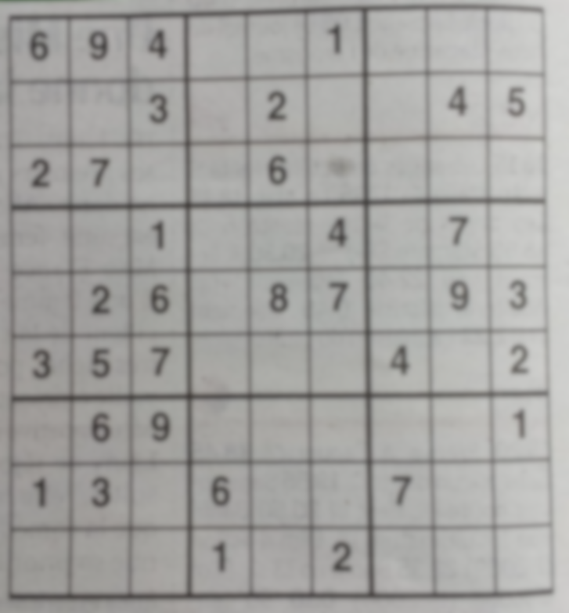
6
9
4
5
2
7
5
I₀
I₁
Notes:
11

Slide 16
An EXPLANATION (E_{i}, S_{i}, N_{i}) of an inference step explains:
E_{i}
S_{i}
=
N_{i}
∧
|
E_{i}
E_{i} ⊆ I_{i}
The explaining facts are a subset of what was previously derived
E₀ = {cells[1,1] = 6, cells[1,2] = 9, cells[1,3] = 4,
cells[3,1] = 2, cells[3,2] = 7, cells[2,9] = 5}
S_{i}
S_{i} ⊆ C
A subset of the problem constraints
S₀ = {alldiff(cells[1:3, 1:3]), alldiff(cells[2, :])}
N_{i}
I_{i+1}\I_{i}
All newly derived information entailed by this explanation
N₀ = {cells[3,3] = 5}

Slide 17
An EXPLANATION (E_{i}, S_{i}, N_{i}) of an inference step explains:
E_{i}
S_{i}
=
N_{i}
∧
|
E_{i}
E_{i} ⊆ I_{i}
The explaining facts are a subset of what was previously derived
S_{i}
S_{i} ⊆ C
A subset of the problem constraints
N_{i}
I_{i+1}\I_{i}
All newly derived information entailed by this explanation
How?
MUS (
I
∧
C
∧
-n
)

Slide 18
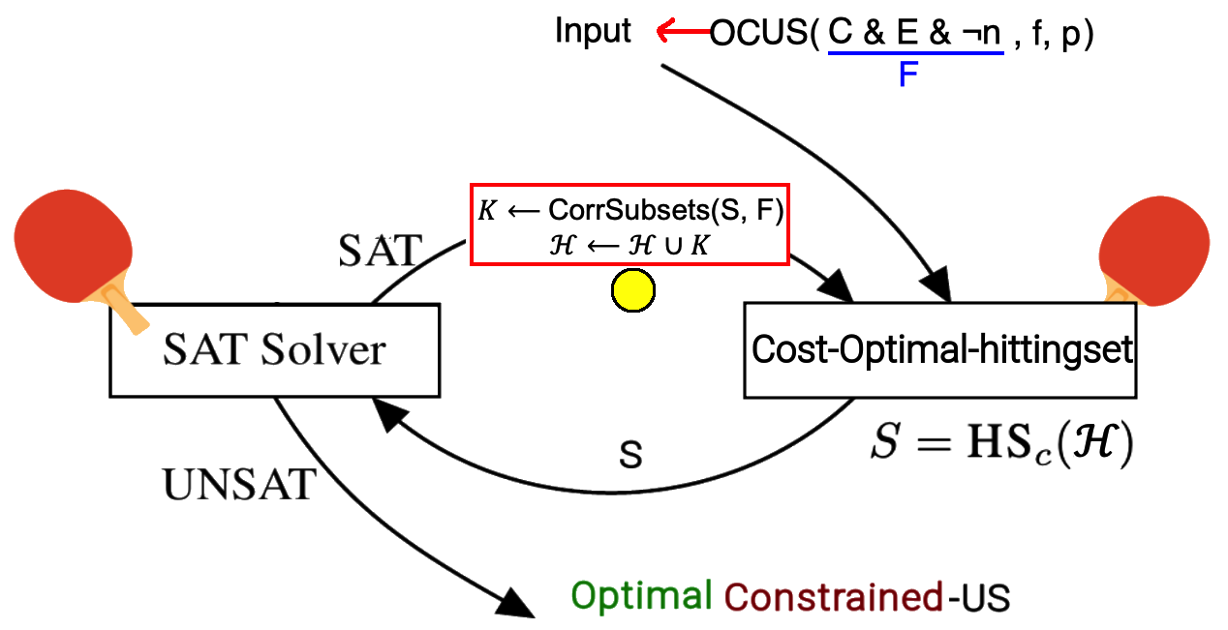
Constrained opt. hittingset

